Slide 1
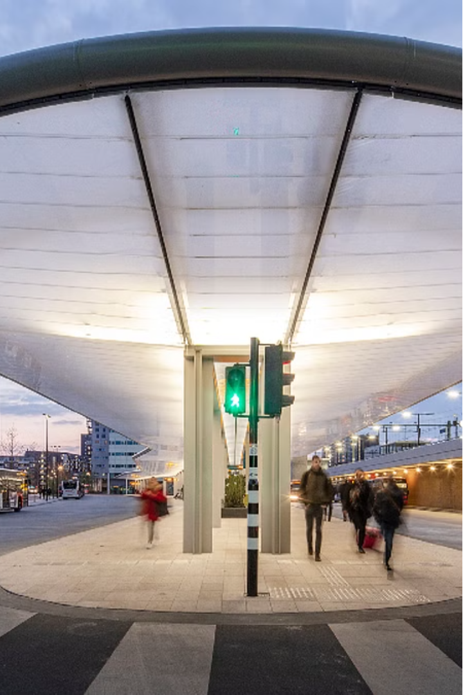

TASK SCHEDULING
Project by:
M.Balaji (192211727)
Guided by:
~Dr.K.JayasakthiVelmn

Slide 2

Scope of Aim
1
Convenient Booking
2
Real-Time Updates
3
Efficient Fleet Management
Enable users to easily search, compare, and book bus tickets online or through mobile apps.
Provide passengers with instant notifications about schedule changes, delays, and seat availability.
Analyze data to optimize routes, schedules, and vehicle utilization for improved operational efficiency.

Slide 3
Existing Systems and Disadvantages
Paper-Based Reservations
Lack of Transparency
Inefficient Operations
Limited information about bus schedules, availability, and real-time updates causes frustration for passengers.
Difficulty in managing routes, fleet, and resources leads to suboptimal utilization and increased costs.
Cumbersome and time-consuming process that often leads to long queues and delays.

Slide 4
Proposed System and Advantages
Intuitive Booking
Real-Time Tracking
Passengers receive instant updates on bus locations, arrivals, and any schedule changes.
Streamlined online/mobile platform for easy bus ticket booking and management.
Optimized Operations
Enhanced Passenger Experience
Advanced data analytics to enhance route planning, fleet utilization, and resource allocation.
Improved reliability, convenience, and responsiveness resulting in higher customer satisfaction.

Slide 5
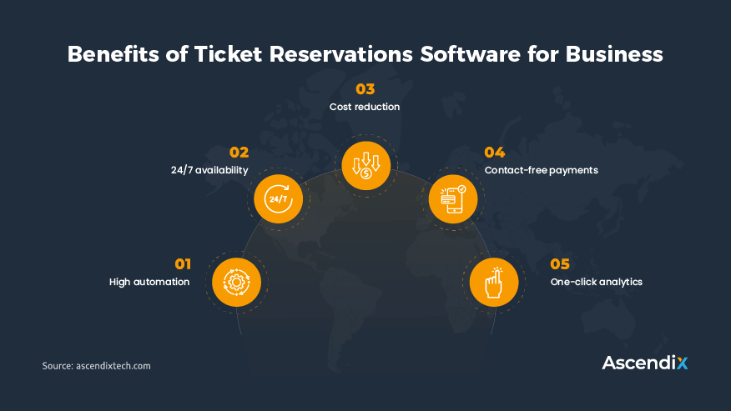

Architecture Diagram
The proposed system architecture integrates a user-friendly web/mobile interface, real-time data processing, and advanced analytics to deliver a comprehensive bus reservation solution.

Slide 6
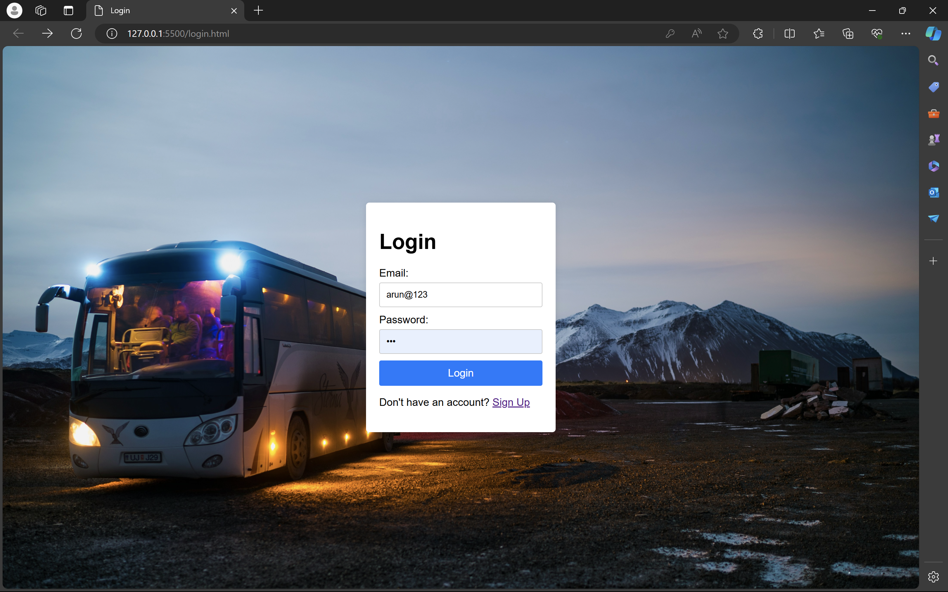
Key Modules
HTML&CSS
HTML is a markup language used to create static web pages and web applications. CSS is a style sheet language responsible for the presentation of documents written in a markup language.

Slide 7
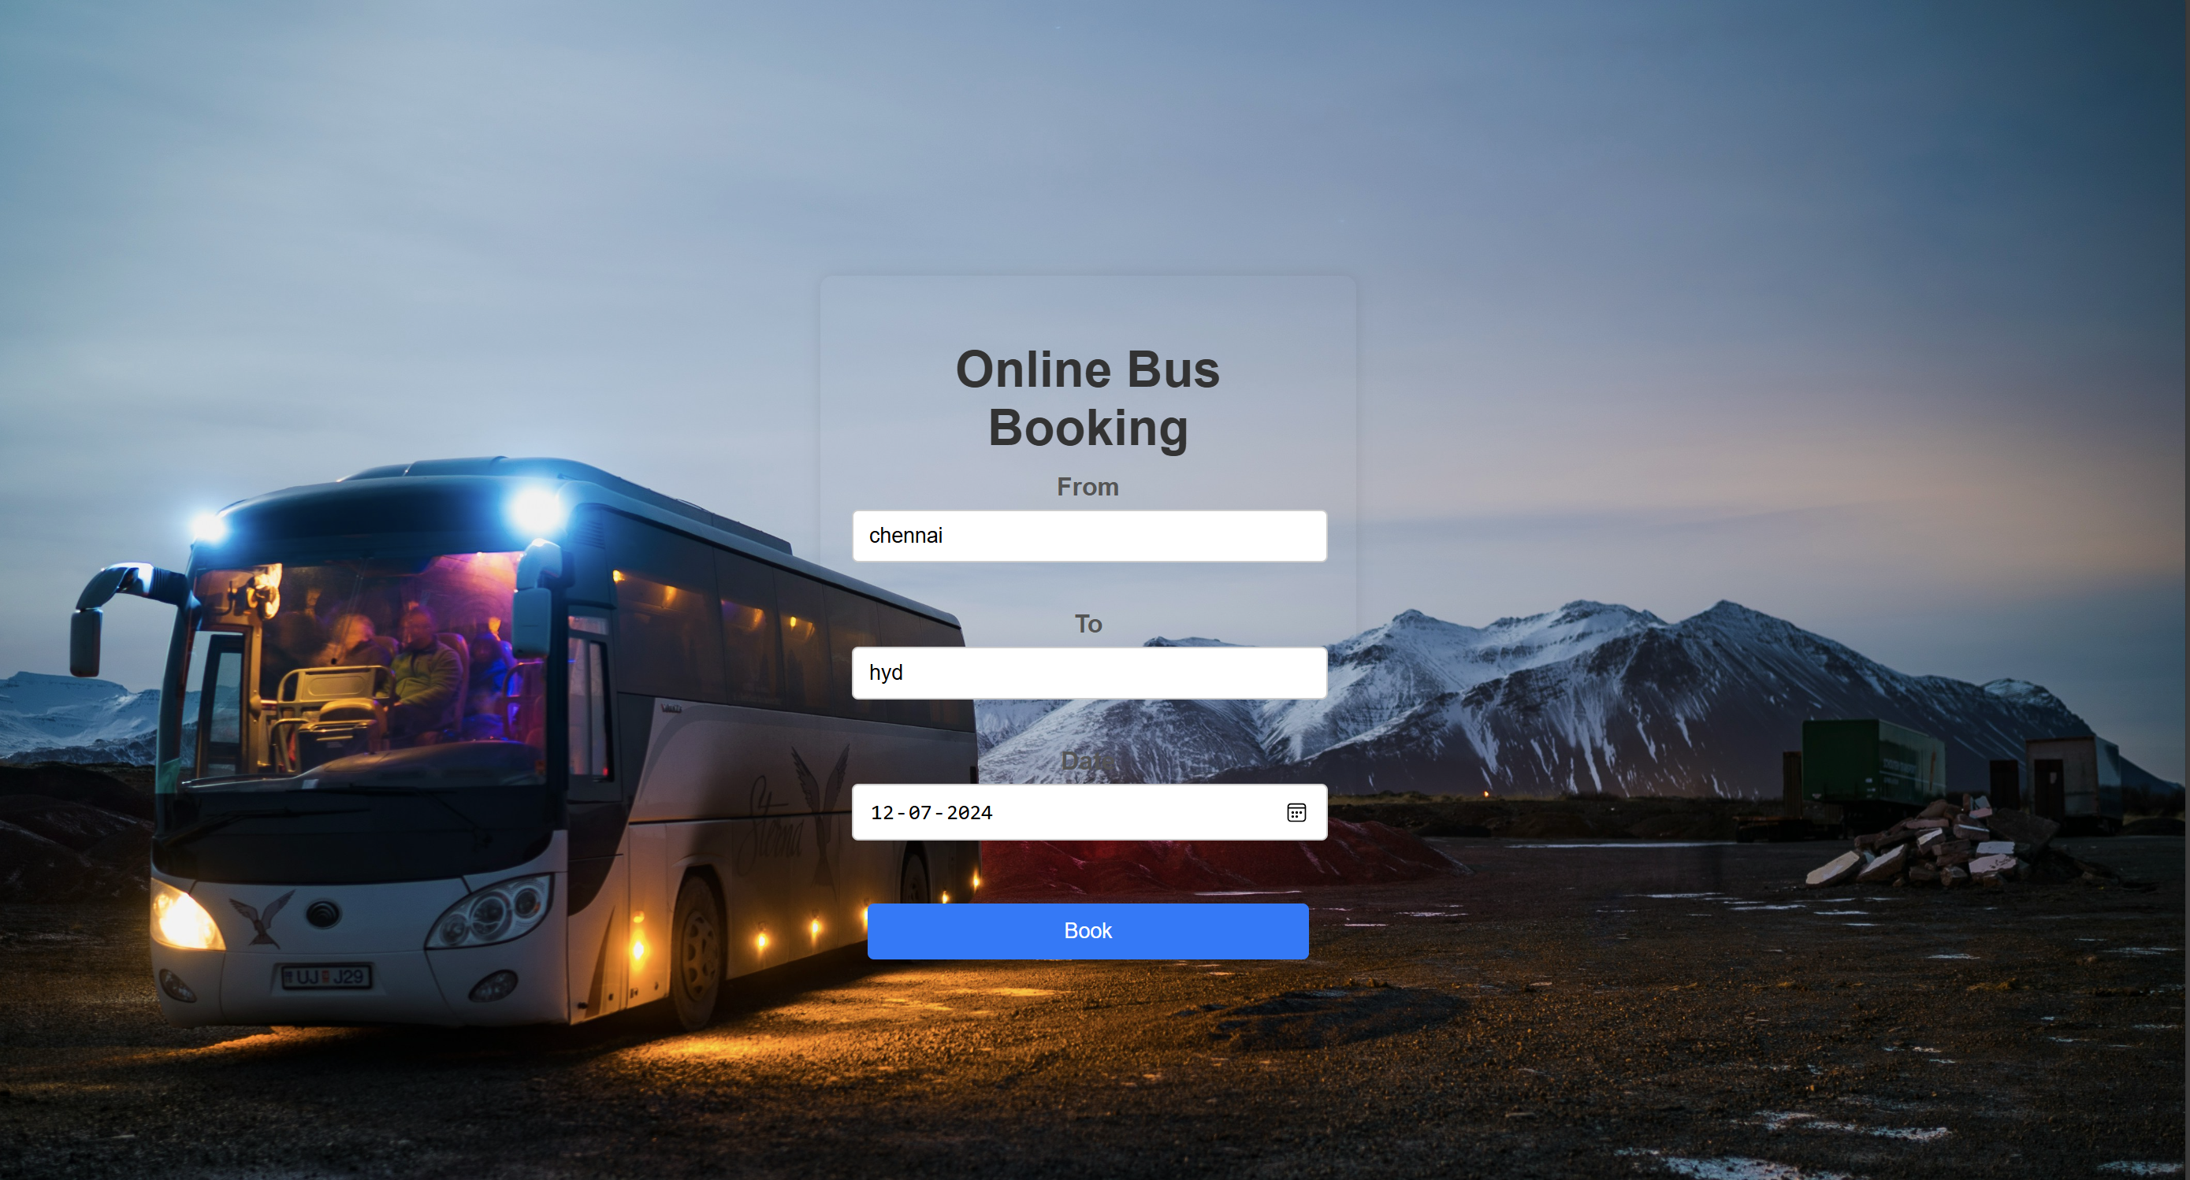
PHP:
HTML is a markup language used to create static web pages and web applications. CSS is a style sheet language responsible for the presentation of documents written in a markup language.

Slide 8
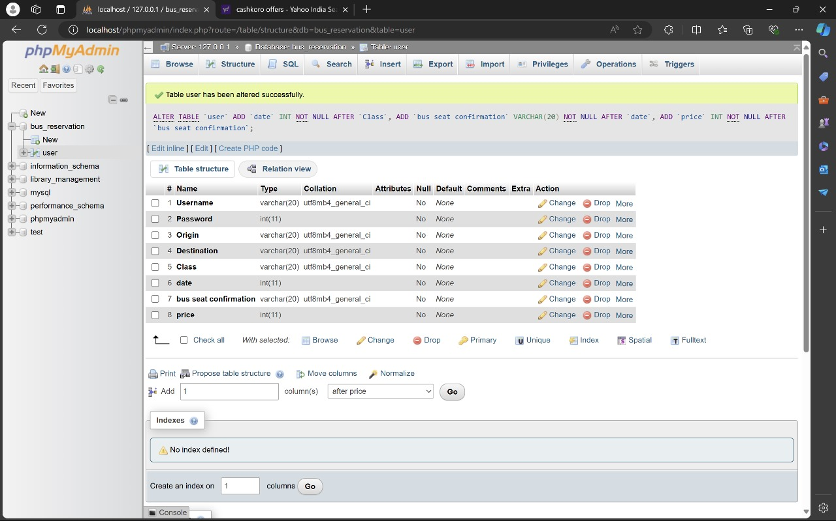
DATABASE OF BUS RESERVATION SYSTEM

Slide 9

Conclusion
The proposed bus reservation system offers a comprehensive solution to transform public transportation, delivering enhanced passenger experience, operational efficiency, and data-driven decision-making for a smarter, more reliable bus service.

Slide 10

References
A Survey on Bus Reservation Systems Optimizing Bus Schedules and Improving Passenger Experience

Slide 11


Slide 12


